Slide 1

Chapter 27 Graphs and Applications

Slide 2
Objectives
To model real-world problems using graphs and explain the Seven Bridges of Königsberg problem (§27.1).
To describe the graph terminologies: vertices, edges, simple graphs, weighted/unweighted graphs, and directed/undirected graphs (§27.2).
To represent vertices and edges using lists, adjacent matrices, and adjacent lists (§27.3).
To model graphs using the Graph interface, the AbstractGraph class, and the UnweightedGraph class (§27.4).
To represent the traversal of a graph using the AbstractGraph.Tree class (§27.5).
To design and implement depth-first search (§27.6).
To design and implement breadth-first search (§27.7).
To solve the nine-tail problem using breadth-first search (§27.8).
To solve the Knight’s Tour problem by reducing it to a Hamiltonian path problem (§27.9).

Slide 3
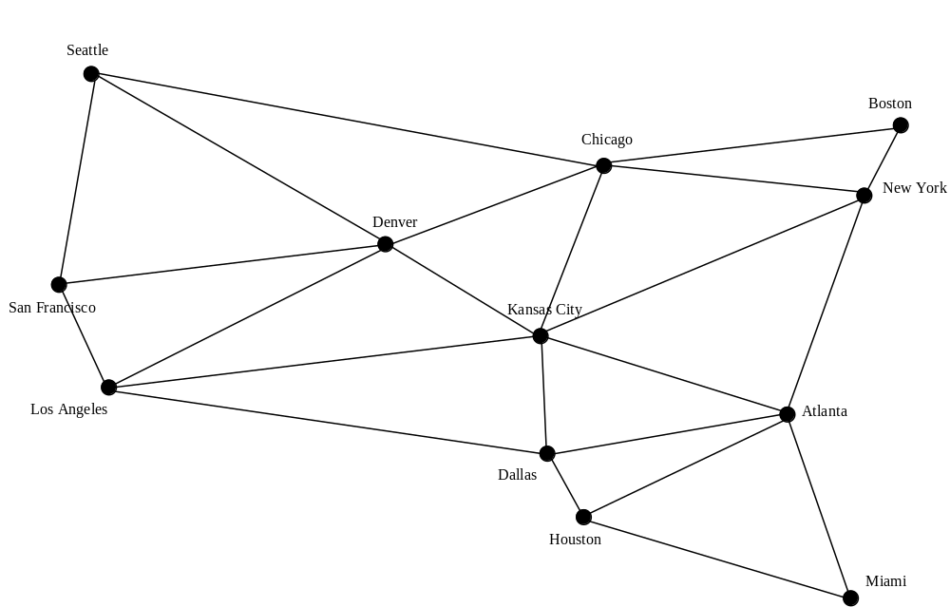
Modeling Using Graphs

Slide 4
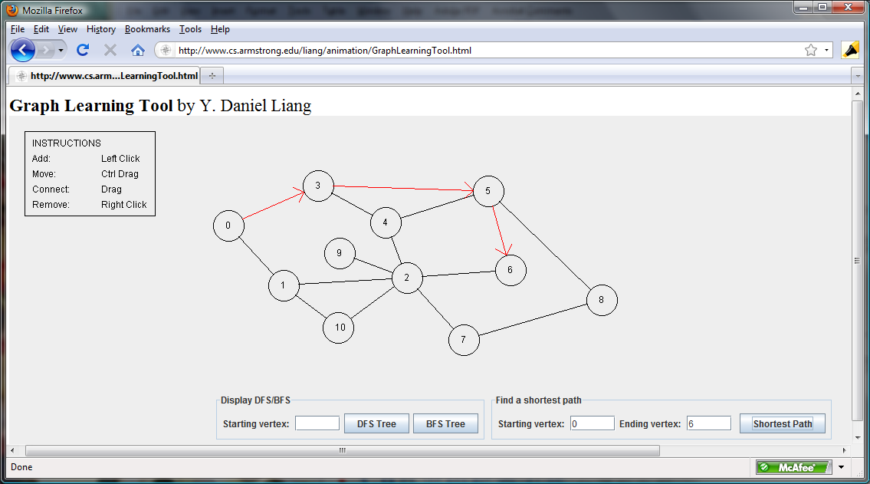
Weighted Graph Animation
www.cs.armstrong.edu/liang/animation/GraphLearningTool.html

Slide 5
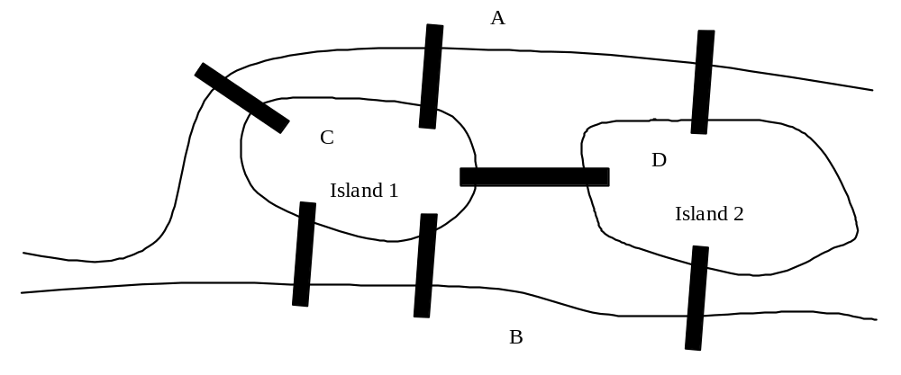
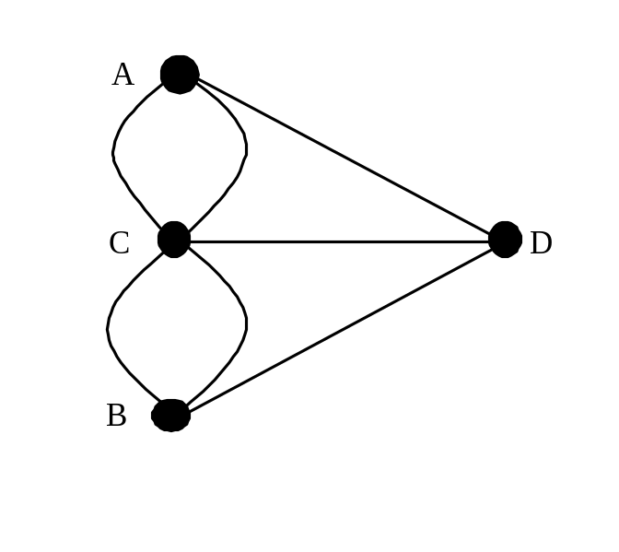
Seven Bridges of Königsberg

Slide 6
Basic Graph Terminologies
What is a graph?
Define a graph
Directed vs. undirected graphs
Weighted vs. unweighted graphs
Adjacent vertices
Incident
Degree
Neighbor
loop

Slide 7
Basic Graph Terminologies
Parallel edge
Simple graph
Complete graph
Spanning tree

Slide 8
Representing Graphs
Representing Vertices
Representing Edges: Edge Array
Representing Edges: Edge Objects
Representing Edges: Adjacency Matrices
Representing Edges: Adjacency Lists

Slide 9
Representing Vertices
String[] vertices = {“Seattle“, “San Francisco“, … };
City[] vertices = {city0, city1, … };
public class City {
}
List<String> vertices;

Slide 10
Representing Edges: Edge Array
int[][] edges = {{0, 1}, {0, 3} {0, 5}, {1, 0}, {1, 2}, … };

Slide 11
Representing Edges: Edge Object
public class Edge {
int u, v;
public Edge(int u, int v) {
this.u = u;
this.v = v;
}
List<Edge> list = new ArrayList<Edge>();
list.add(new Edge(0, 1)); list.add(new Edge(0, 3)); …

Slide 12
Representing Edges: Adjacency Matrix
int[][] adjacencyMatrix = {
{0, 1, 0, 1, 0, 1, 0, 0, 0, 0, 0, 0}, // Seattle
{1, 0, 1, 1, 0, 0, 0, 0, 0, 0, 0, 0}, // San Francisco
{0, 1, 0, 1, 1, 1, 0, 0, 0, 0, 0, 0}, // Los Angeles
{1, 1, 1, 0, 1, 1, 0, 0, 0, 0, 0, 0}, // Denver
{0, 0, 1, 1, 0, 1, 0, 1, 1, 0, 1, 0}, // Kansas City
{1, 0, 0, 1, 1, 0, 1, 1, 0, 0, 0, 0}, // Chicago
{0, 0, 0, 0, 0, 1, 0, 1, 0, 0, 0, 0}, // Boston
{0, 0, 0, 0, 1, 1, 1, 0, 1, 0, 0, 0}, // New York
{0, 0, 0, 1, 1, 0, 0, 1, 0, 1, 1, 1}, // Atlanta
{0, 0, 0, 0, 0, 0, 0, 0, 1, 0, 0, 1}, // Miami
{0, 0, 1, 0, 1, 0, 0, 0, 1, 0, 0, 1}, // Dallas
{0, 0, 0, 0, 0, 0, 0, 0, 1, 1, 1, 0} // Houston
};

Slide 13
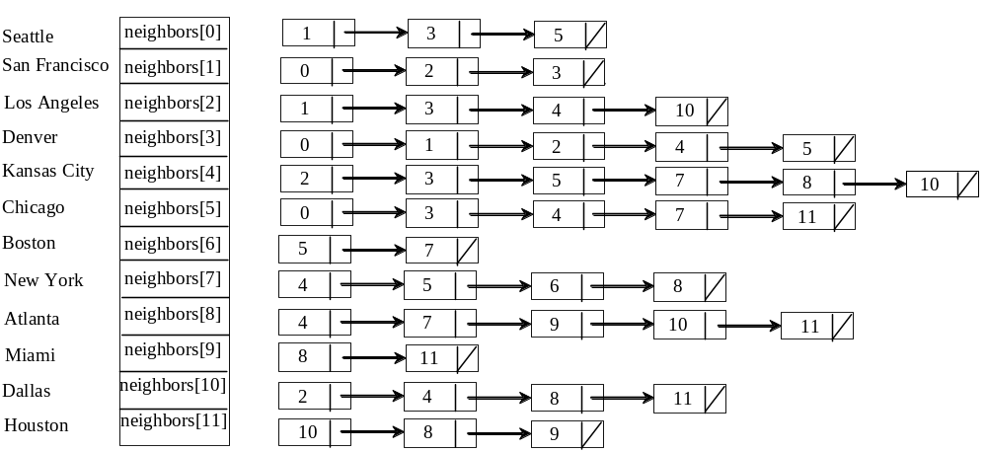
Representing Edges: Adjacency List
List<Integer>[] neighbors = new LinkedList<Integer>[12];

Slide 14
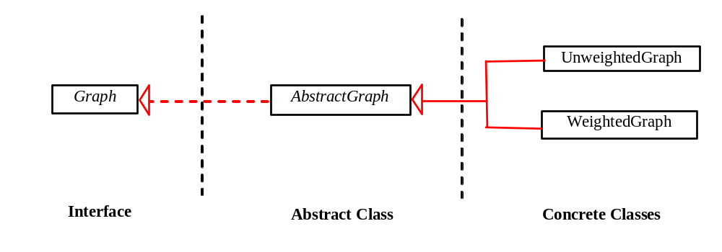
Modeling Graphs

Slide 15
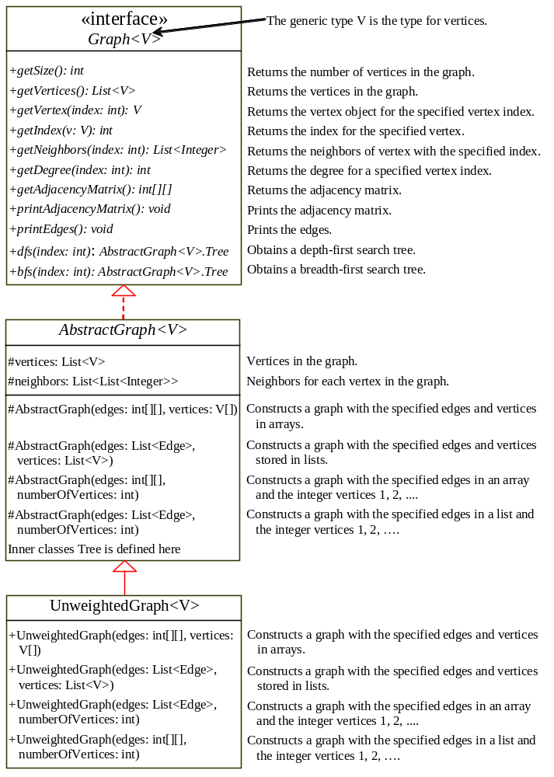
Graph
AbstractGraph
UnweightedGraph
TestGraph
TestGraph

Slide 16
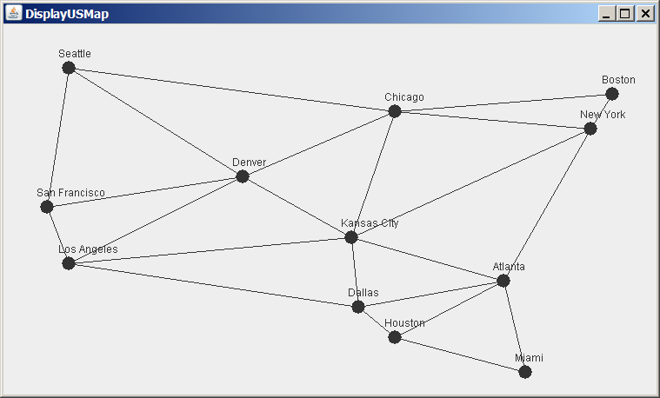
Graph Visualization
Displayable Interface
DisplayUSMap
GraphView
Run

Slide 17
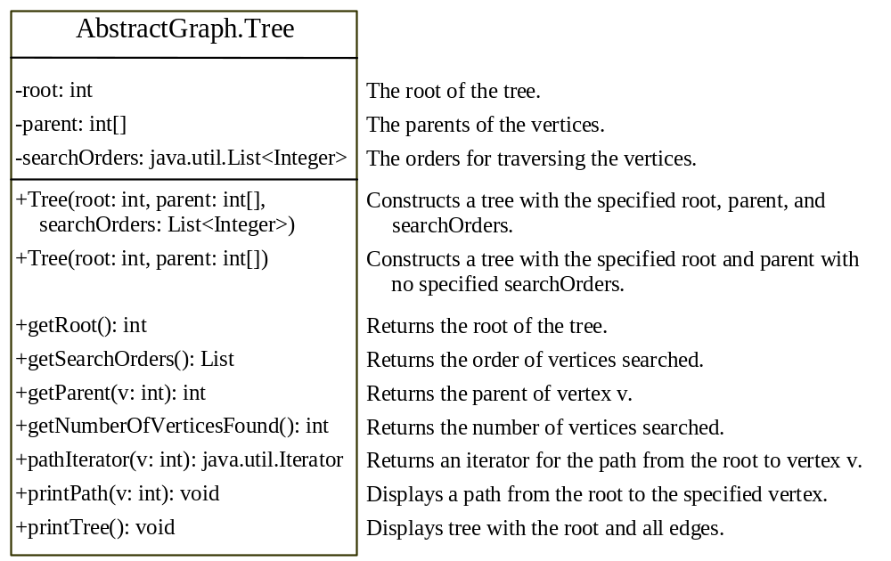
Graph Traversals
Depth-first search and breadth-first search
Both traversals result in a spanning tree, which can be modeled using a class.

Slide 18
Depth-First Search
The depth-first search of a graph is like the depth-first search of a tree discussed in §25.2.3, “Tree Traversal.” In the case of a tree, the search starts from the root. In a graph, the search can start from any vertex.
dfs(vertex v) {
visit v;
for each neighbor w of v
if (w has not been visited) {
dfs(w);
}
}

Slide 19
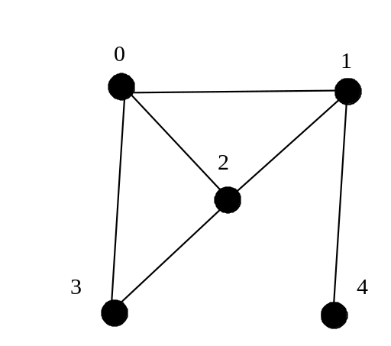
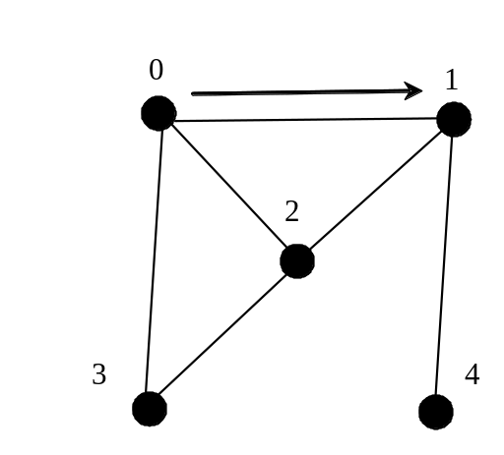
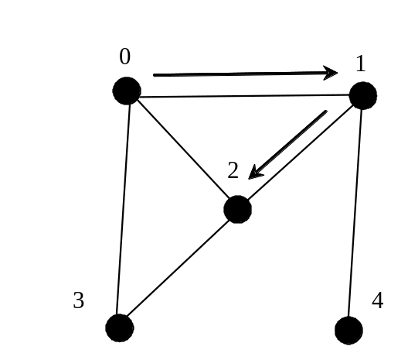
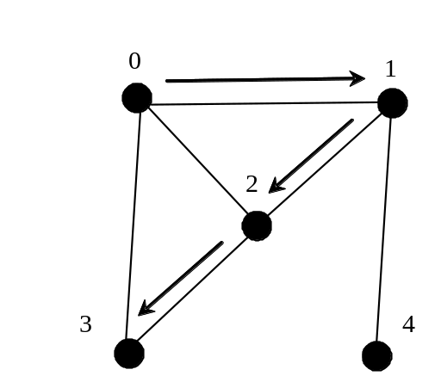
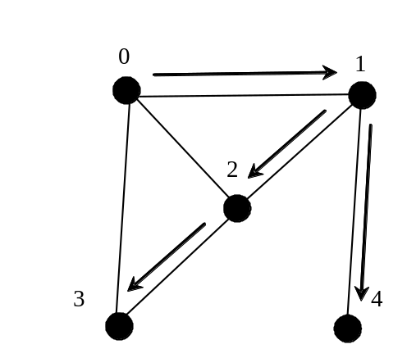
Depth-First Search Example

Slide 20
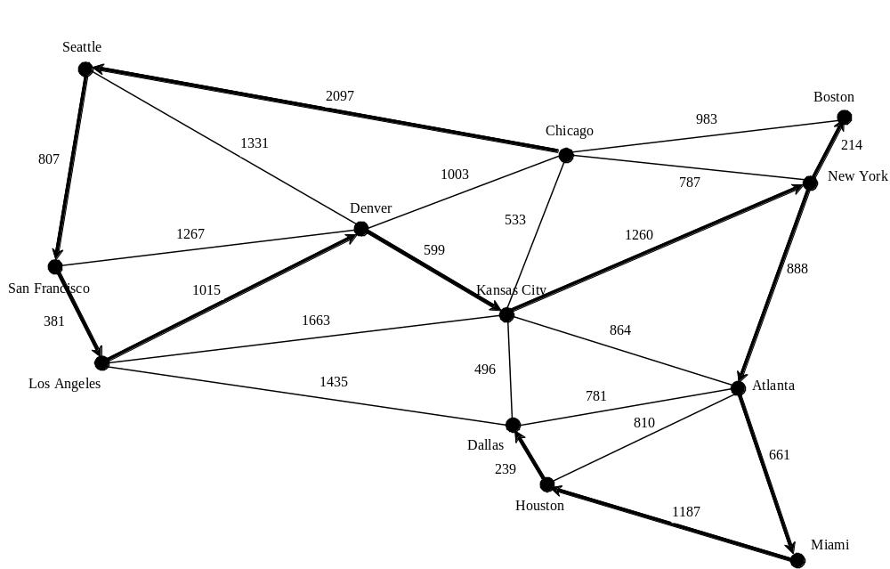
Depth-First Search Example
TestDFS
TestDFS

Slide 21
Applications of the DFS
Detecting whether a graph is connected. Search the graph starting from any vertex. If the number of vertices searched is the same as the number of vertices in the graph, the graph is connected. Otherwise, the graph is not connected (See Exercise 27.2.)
Detecting whether there is a path between two vertices. (See Exercise 27.3)
Finding a path between two vertices. (See Exercise 27.3)
Finding all connected components. A connected component is a maximal connected subgraph in which every pair of vertices are connected by a path. (See Exercise 27.2)
Detecting whether there is a cycle in the graph. (See Exercise 27.4)
Finding a cycle in the graph. (See Exercise 27.5)

Slide 22
Breadth-First Search
The breadth-first traversal of a graph is like the breadth-first traversal of a tree discussed in §25.2.3, “Tree Traversal.” With breadth-first traversal of a tree, the nodes are visited level by level. First the root is visited, then all the children of the root, then the grandchildren of the root from left to right, and so on.

Slide 23
Breadth-First Search Algorithm
bfs(vertex v) {
create an empty queue for storing vertices to be visited;
add v into the queue;
mark v visited;
while the queue is not empty {
dequeue a vertex, say u, from the queue
process u;
for each neighbor w of u
if w has not been visited {
add w into the queue;
mark w visited;
}
}
}

Slide 24
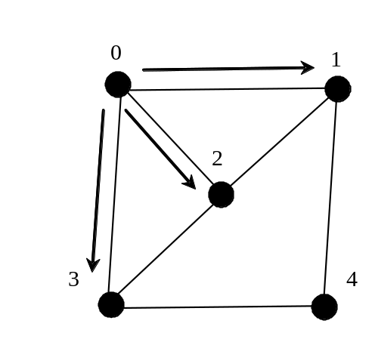
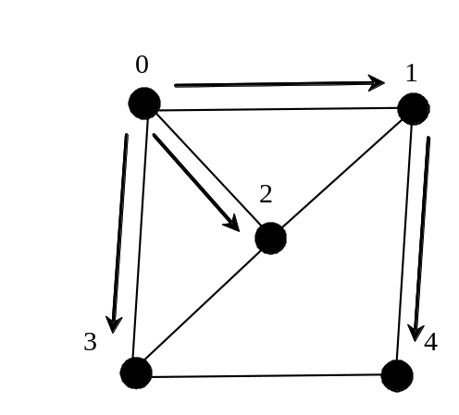
Breadth-First Search Example
Queue: 0
isVisited[0] = true
Queue: 1 2 3
isVisited[1] = true, isVisited[2] = true, isVisited[3] = true
Queue: 2 3 4
isVisited[4] = true

Slide 25
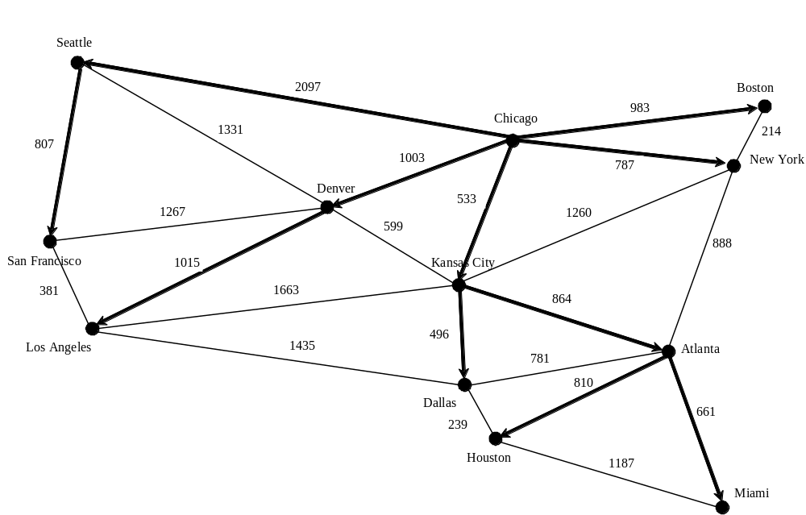
Breadth-First Search Example
TestBFS
TestBFS

Slide 26
Applications of the BFS
Detecting whether a graph is connected. A graph is connected if there is a path between any two vertices in the graph.
Detecting whether there is a path between two vertices.
Finding a shortest path between two vertices. You can prove that the path between the root and any node in the BFS tree is the shortest path between the root and the node (see Review Question 27.10).
Finding all connected components. A connected component is a maximal connected subgraph in which every pair of vertices are connected by a path.
Detecting whether there is a cycle in the graph. (See Exercise 27.4)
Finding a cycle in the graph. (See Exercise 27.5)
Testing whether a graph is bipartite. A graph is bipartite if the vertices of the graph can be divided into two disjoint sets such that no edges exist between vertices in the same set. (See Exercise 27.8)

Slide 27
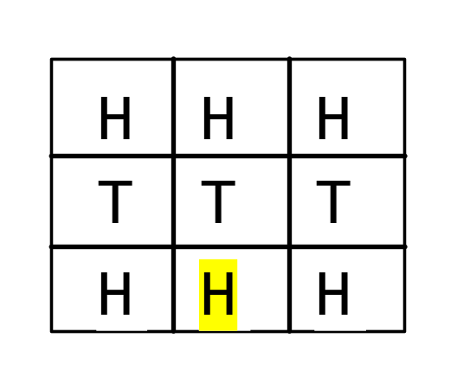
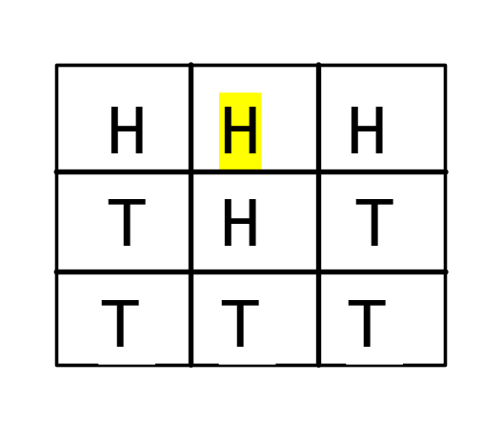
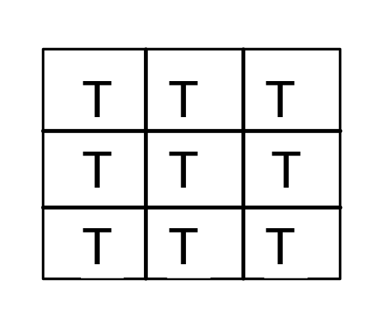
The Nine Tail Problem
The problem is stated as follows. Nine coins are placed in a three by three matrix with some face up and some face down. A legal move is to take any coin that is face up and reverse it, together with the coins adjacent to it (this does not include coins that are diagonally adjacent). Your task is to find the minimum number of the moves that lead to all coins face down.

Slide 28
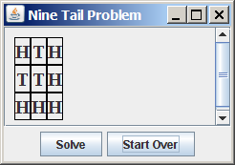
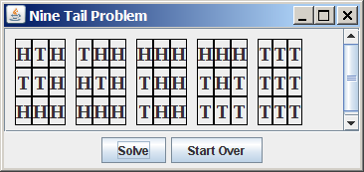
The Nine Tail Problem
NineTailModel
NineTailApp
NineTailApp

Slide 29
The Hamiltonian Path Problem
A Hamiltonian path in a graph is a path that visits each vertex in the graph exactly once. A Hamiltonian cycle is a cycle that visits each vertex in the graph exactly once and returns to the starting vertex.
A Hamiltonian path and cycle have many applications.

Slide 30
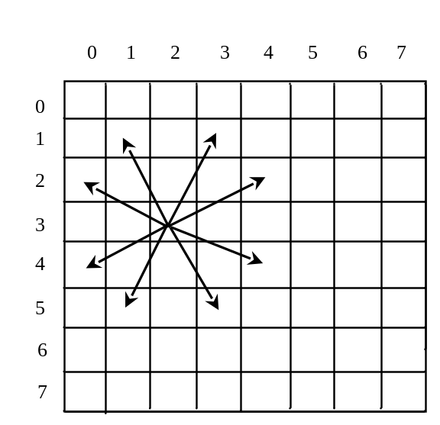
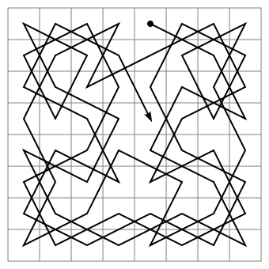
The Knight’s Tour Problem
The Knight’s Tour is a well-known classic problem. The objective is to move a knight, starting from any square on a chessboard, to every other square once. Note that the knight makes only L-shape moves (two spaces in one direction and one space in a perpendicular direction). As shown in Figure 27.19(a), the knight can move to eight squares.

Slide 31
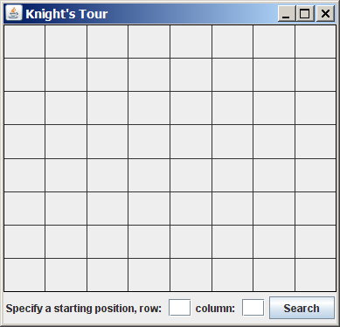
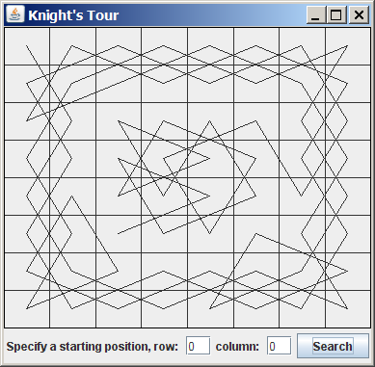
Find a Knight’s Tour
To solve the Knight’s Tour problem, create a graph with 64 vertices representing all the squares in the chessboard. Two vertices are connected if a knight can move between the two vertices.
KnightTourModel
KnightTourApp
KnightTourApp

